Slide 1
Additive Manufacture within BAE Systems Air Sector
Kevin Pickup
Lead Engineer – NDT – Responsible Level 3
Acknowledgments:
Matt Stevens Rebecca Clamp, Peter Stewart – New Product & Process Development Centre - BAE

Slide 2
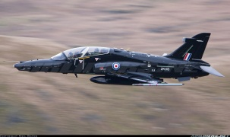
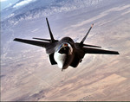
BAE SYSTEMS Air Sector
A through-life business delivering information superiority and air power to our customers in the UK and overseas.
Core capabilities include in-service support, systems integration, information systems and services, rapid engineering, manufacturing, maintenance, repair and upgrade and military training.
Programmes include production of Typhoon combat and Hawk trainer aircraft, F-35 Lightning II sub-assembly manufacture, support and upgrades for Typhoon, Tornado and Hawk aircraft and the development of next generation of Remotely Piloted Air Systems and defence information systems.
24 UK sites with a presence in Germany, Saudi Arabia, Australia and the US.

Slide 3
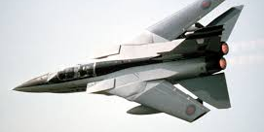
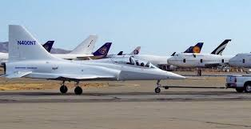
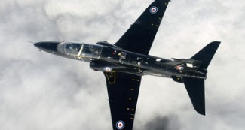
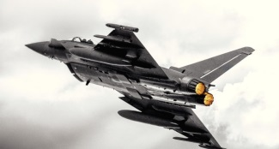
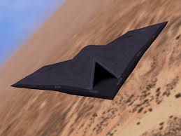
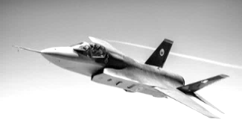
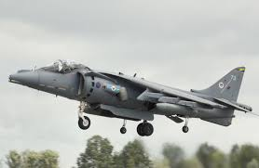
Military Air & Information Aircraft Programmes & Manufacturing Context
Concept
Assessment
Development
Manufacture
In-Service
Disposal
Tornado
TX
Hawk
Typhoon
Future Programmes
F35
Harrier
/ AV8B

Slide 4
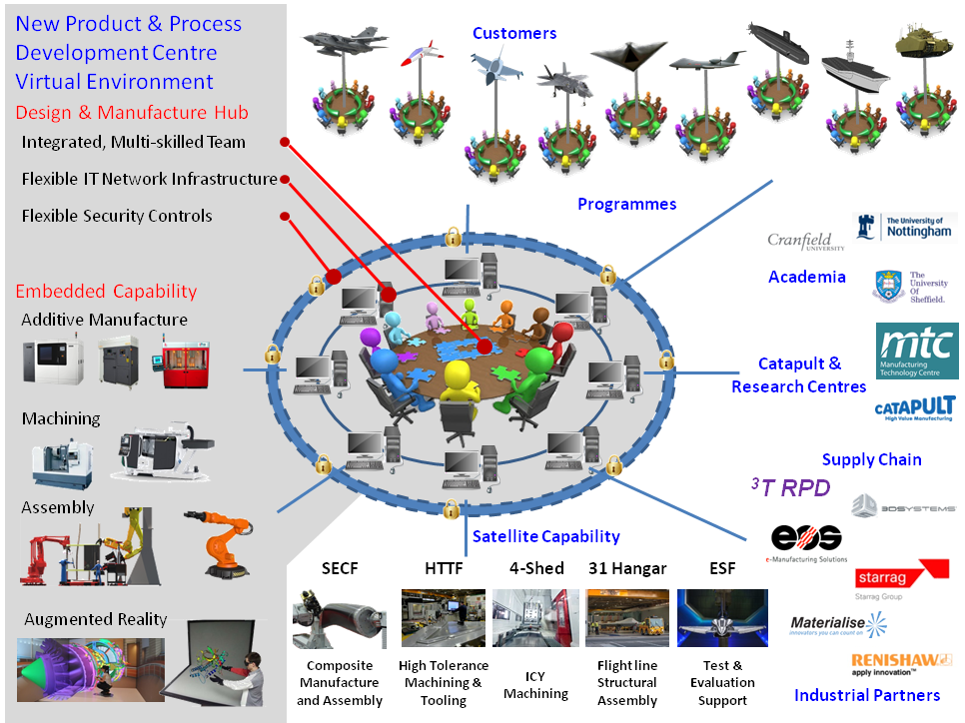
New Product & Process Development Centre (NPPDC) Vision

Slide 5
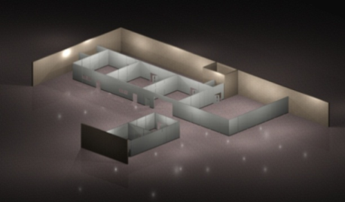
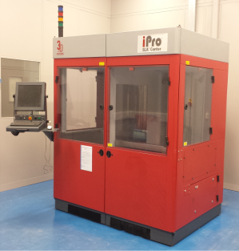
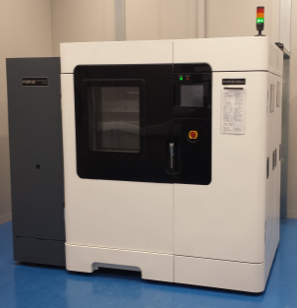
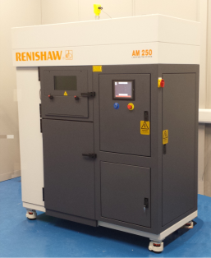
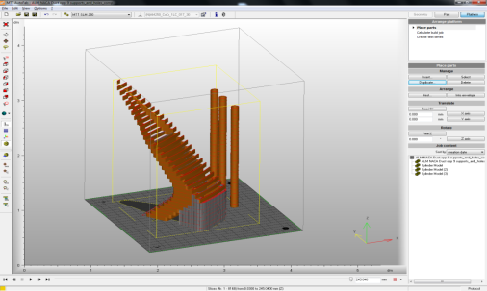
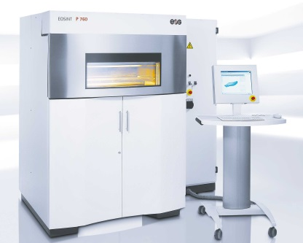
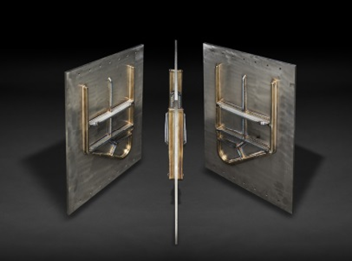
NPPDC - Our Capability so far…
Stereolithography
Fused Deposition Modelling
Selective Laser Melting
Design & Engineering
Selective Laser Sintering
Selective Laser Sintering
Metallic Wire Deposition
UV Cured Resin Process
Build Envelope
650 x 750 x 300mm
Dual System Capability
Extruded Plastic Deposition Process
Build Envelope
600 x 900 x 600mm
3 x Primary Machine +
Multiple Smaller Machine Capability
Laser Sintered, Metallic Powder Bed Process
Build Envelope 250 x 250 x 300mm
Stainless Steel and Commercially Pure Titanium Capability
3D Modelling Software
Design Optimisation for Additive Manufacturing
Topological Design Optimisation
Laser Sintered, Nylon
Powder Bed Process
Build Envelope
700 x 380 x 580mm
Extensive Power Handling Systems

Slide 6
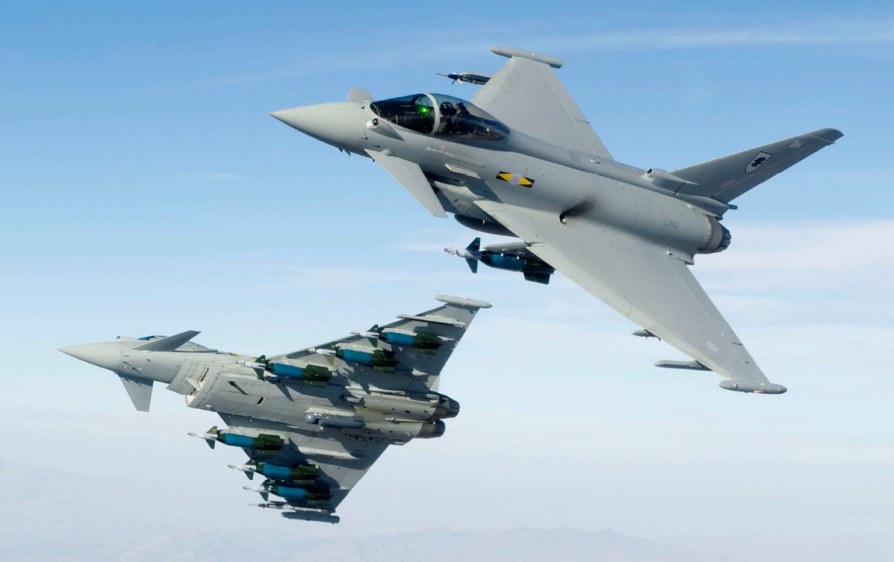
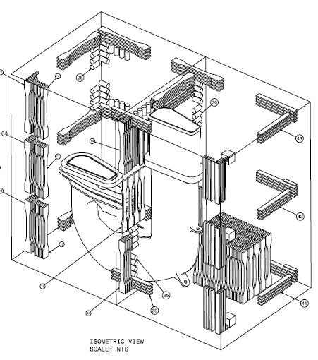
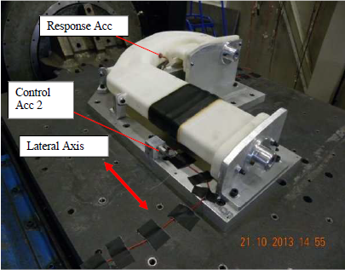
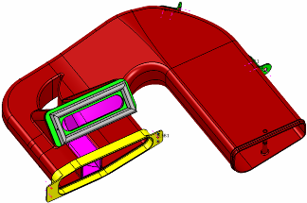
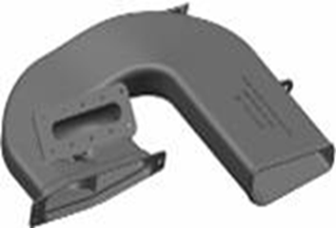
Case Study ECS duct part consolidation & performance enhancement
Background
The Typhoon aircraft is going to have an upgraded E-scan radar system
Higher level of cooling required from ECS system.
Opportunity to improve design, reduce the number of parts
SLS PA2241FR material fully qualified

Slide 7
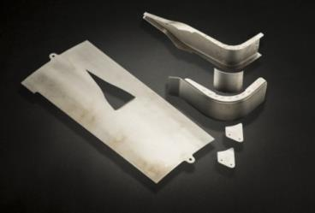
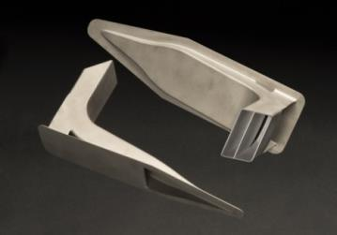
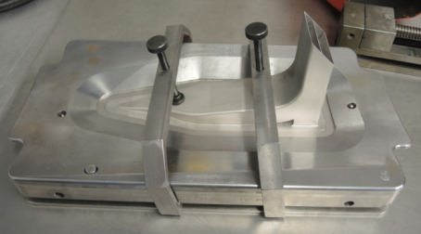
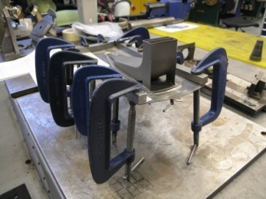
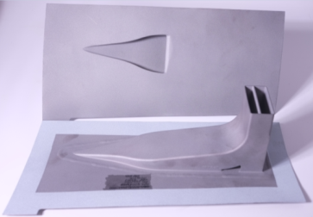
Case Study Hawk NACA Intake: Programme Execution
Business Case Submission
Production Change
New Manufacture
Materials Testing & Production Qualification
Design Iterations
Conventional manufacture – welding fabrication from multiple component parts
High concession rate, resulting in build shortages and production delays
Alternative manufacture approach required, to:
Meet rate requirements
Improve build quality & methodology
Provide cost & lead time saving
Conventional Manufacture
AM part
8 months
Conventional Manufacture
Unitised design & increased build rate
36% material & manufacturing cost reduction per component
62% lead time reduction
New tooling and weld process implemented to enable efficient and accurate welding
New Weld Tooling
Old Weld Tooling
Full Assembly – AM part welded to panel
Achieved 1st fully qualified metallic component

Slide 8
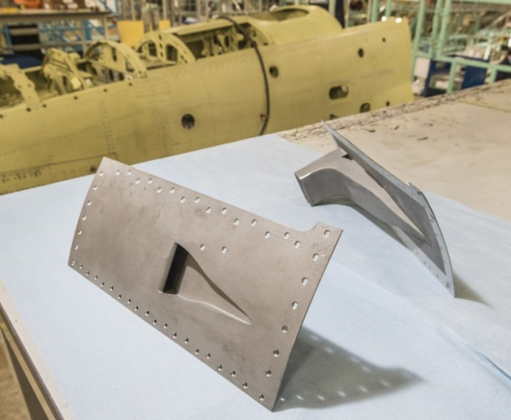
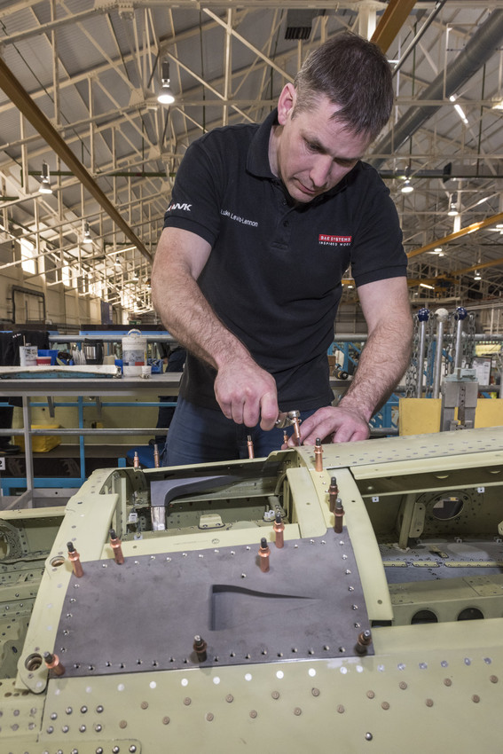
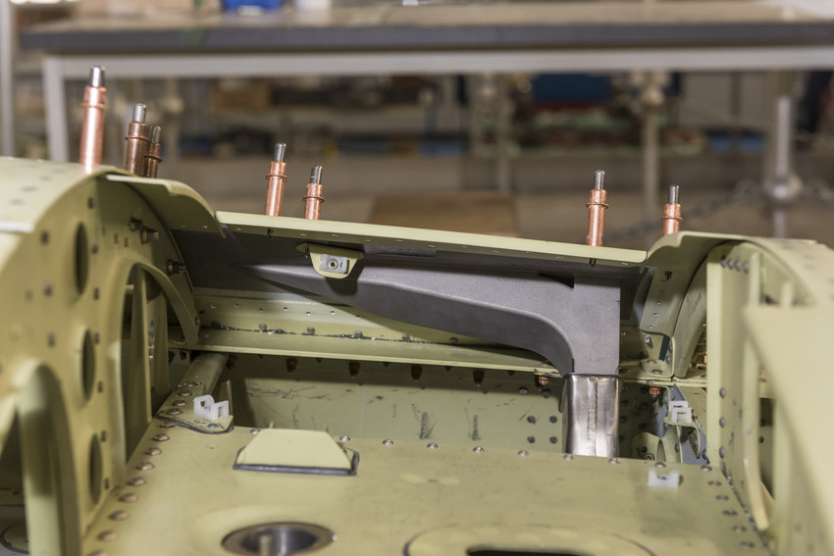
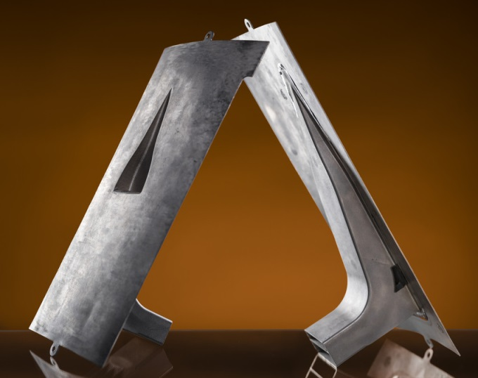
Case Study Hawk NACA Intake
December 2015
Achievement of 1st fully qualified Additive Manufactured metallic component on a customer product
March 2017 FIRST FLIGHT

Slide 9
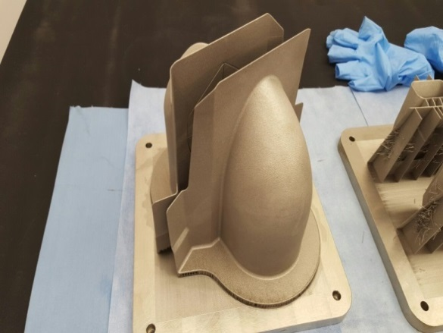
Hawk Development Qualified Product Production
Pre-Production NACA Inlet Pipe
Pre-Production RAM Air Intake
Pre -Production Tin Can
Old Standard
New AM Part
Old Standard
New AM Part
Old Standard
New AM Part
Benefits delivered
52% cost saving per aircraft (combined man hour savings & material savings)
Lead time decrease by an average of 82% across all three parts
Unitisation of parts
Production easement – design for AM & fitment of components to aircraft
Improved accuracy and repeatability
Improved quality

Slide 10
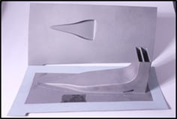
Routes taken to Qualification for airframe applications
Assess
Design
Validate
Qualify
Process
Materials
Qualification
Assess potential benefits and theoretical properties.
Establish process parameters
Define test philosophy and programme
Undertake physical testing: -
Destructive
Non-destructive.
Verify materials properties and confirm process parameters.
Part
Qualification
Design for Additive Manufacture.
Define process parameters and materials properties.
Undertake physical testing: -
Destructive
Non-destructive.
Assess function and manufacturability

Slide 11
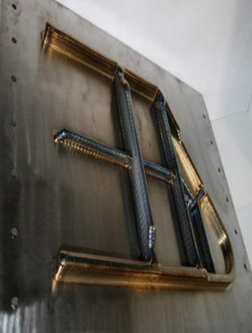
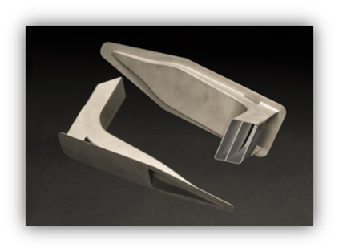
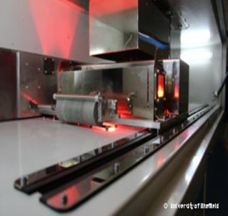
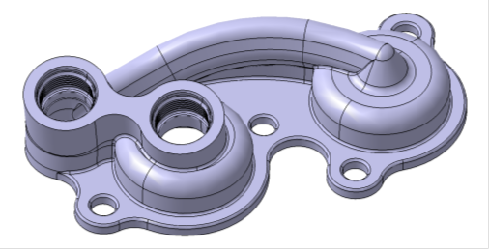
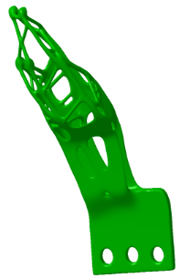
Future Developments
SLS Nylon 12
Finalise facility
Qualify for production components
Mature integrated workload
Ti SLM
Finalise quality systems for in house CpTi facility
Pursue qualification of next tranche of components
Maturation of Engineering solutions
Utilise lessons learnt for additional material types
Steel SLM
Finalise component design and qualify component
Establish “End to End” manufacturing solution
Support other BAES Business units
LARGE Ti DEPOSITION
Large Primary Structure
Mature Process
Engineering approach established
Establish production facility
FACTUM (High Speed Sintering)
Develop Business Case recognising reduced processing times
High performance & nano-enabled polymers
Multi-material polymers
TOPOLOGICAL OPTIMISATION
Validate results through structural test
Mature Engineering toolset
Deployment planning

Slide 12
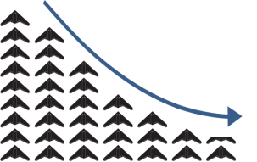
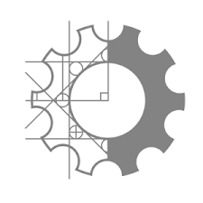
Manufacturing Challenges Within Military Aircraft Sector
Higher variety,
bespoke spec requirements
Smaller order / batch volumes
Increased specification & customer needs
Reduced Supply Chain capability
& leverage
Customer demands reduced cost
& lead-times
NEED TO DEVELOP ADAPTIVE AND INNOVATIVE SOLUTIONS
Notes:
Within the Military Air Sector we face a number if emerging challenges:
5th Gen fighters, such as F-35 and Typhoon, will dominate the fast jet market therefore a new large scale manufacturing programme is unlikely for several decades. Until a large scale 6th Gen programme emerges, it is expected that military a/c orders will be of a higher variety and bespoke specification and therefore be in smaller batches.
Coupled with this, further unitisation will drive the need for larger parts. These 3 factors combined will reduce capability and leverage within the supply chain, especially when up against the high volume civil aerospace sector.
Further, increased customer specification coupled with a reduced supply chain places a demand for both new materials and new manufacturing technologies.
These challenges, compounded by ever increasing affordability and timescale constraints, drive the need to increase collaboration across the industry.

Slide 13
NDT Challenges from AM Builds MATERIAL QUALIFICATION
MATERIAL QUALIFICATION
For materials that do not require NDT as a finished item (SLS), but require NDT as part of the material and part qualification process
For machined coupons, regular methods can be used
Prototype or FAVe –
CT a possible option
Surface finish is a big issue

Slide 14
NDT Challenges from AM Builds POST BUILD NDT
POST BUILD NDT
Material Classification – what is it?
Billet
Casting
Weld
Inspection of parts with ROUGH surfaces (minimum added value before NDT)
Penetrant inspection compromised
Ultrasonic
Inspection of Complex & Challenging Geometry/topologically optimised shapes
Can you see the ROI?
Is there sufficient contact surface for inspection
Thinner structures as optimised shape reduces mass
Near Net Shape Products
No longer sufficient sacrificial material to allow for dead zones

Slide 15
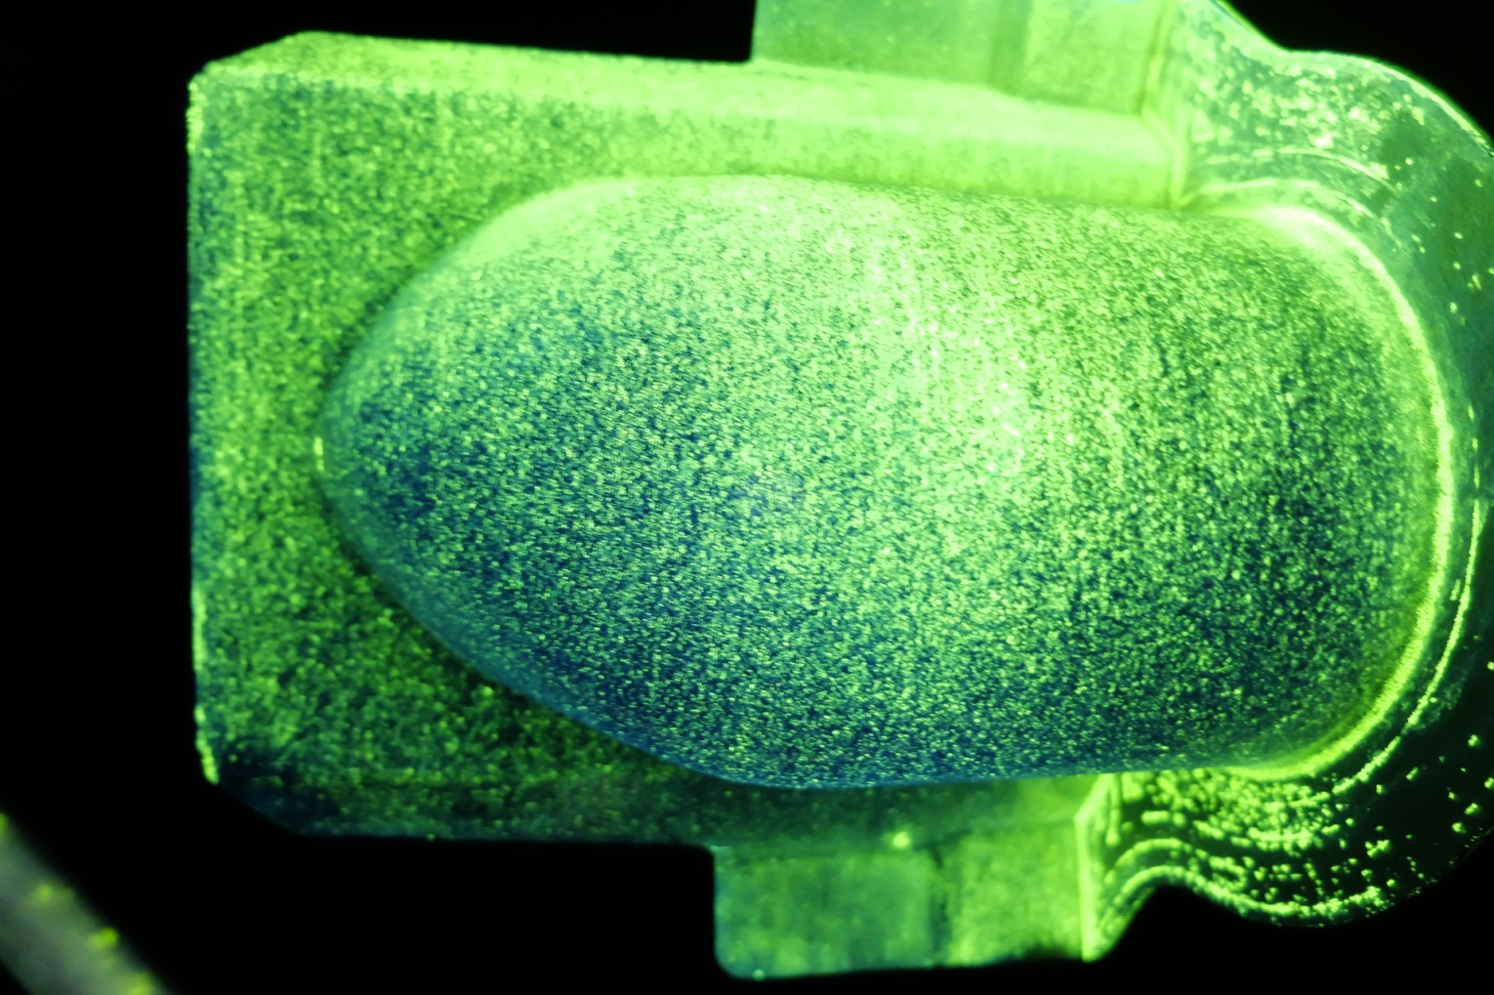
PFD Inspection of SLM AM Part
Type 1, Level 2, form a.
Is this acceptable background?
Surface finish enhancement is required for both Material Performance and NDT

Slide 16
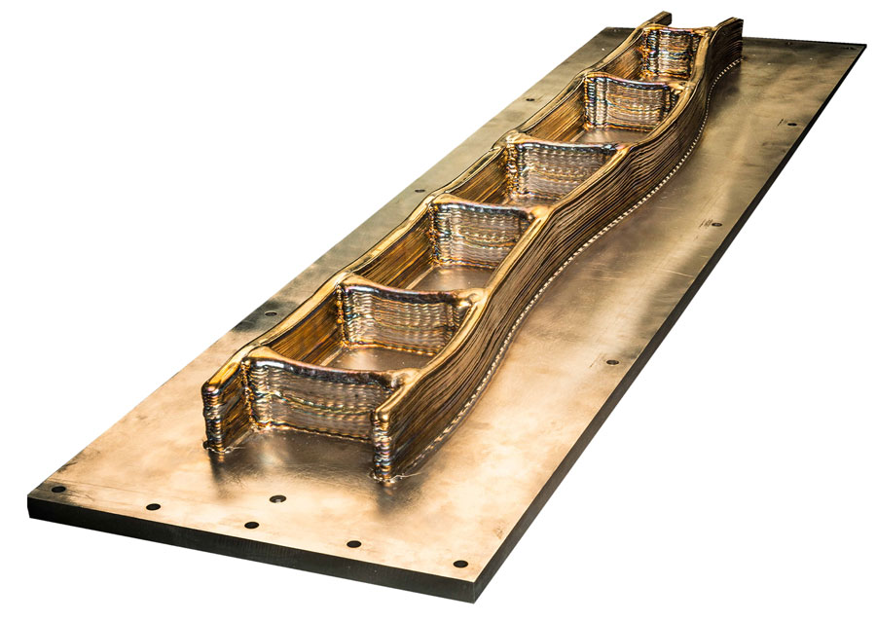
TYPICAL WAM PART TO REPLACE TRADITIONAL FORGING

Slide 17
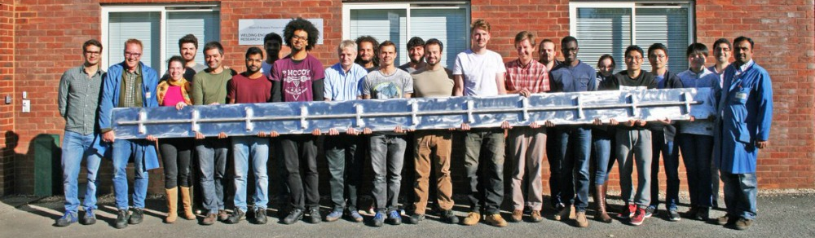
LARGE WAM PART (Curtesy of Cranfield University)
It is already conceived of printing an entire airframe

Slide 18
TOPOLOGICALLY OPTIMISED PARTS

Slide 19
NDT Challenges from AM Builds IN BUILD NDT
Can we remove the need for POST BUILD by embracing IN BUILD NDT?
SRAS
TRANSIENT ET
LUT
OPTICAL/Visual/IR
??????????

Slide 20
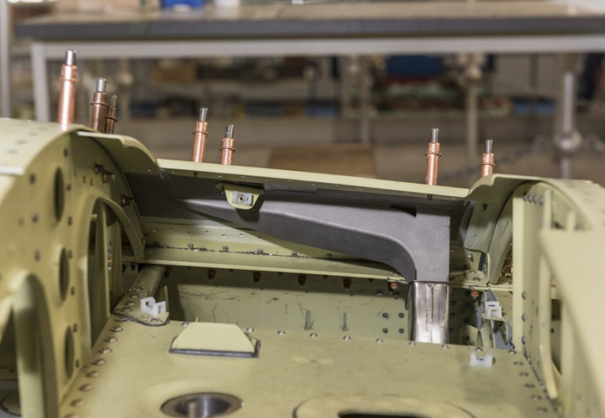
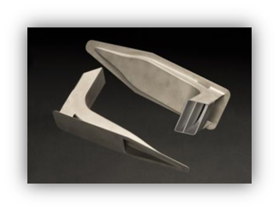
Thank you
Restrictions on use:
This publication is issued to provide outline information only. No advice given or statements or recommendations made shall in any circumstances constitute or be deemed to constitute a warranty or representation by BAE Systems as to the accuracy or completeness of such advice, statements or recommendations. BAE Systems shall not be liable for any loss, expense, damage or claim howsoever arising out of the advice given or not given or statements made or omitted to be made in connection with this document. No part of this document may be copied, reproduced, adapted or redistributed in any form or by any means without the express prior written consent of BAE Systems.

